Slide 1

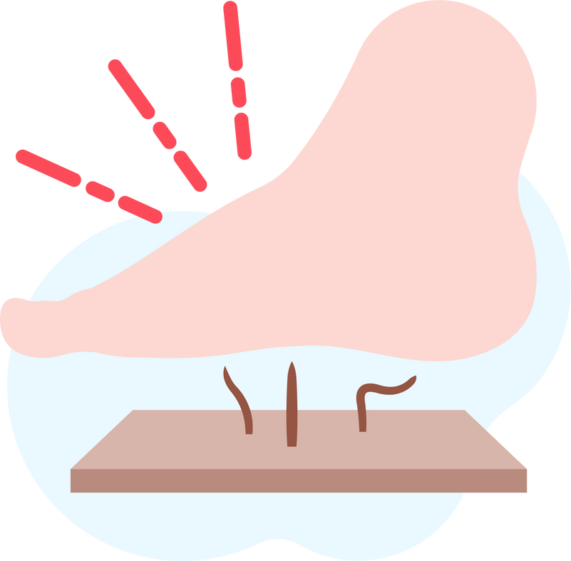
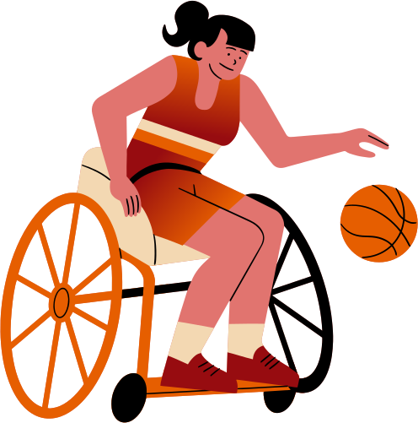


Lightning Talk 4:
Project Planning
PRESSURE SENSOR PATCH
sdmay25-12
Advisor: Santosh Pandey
Client: BAE Systems

Slide 2
Project Overview
Objective
Target Users
Core Functionality
Key Features
Develop a pressure sensor patch for adaptive sports athletes to monitor pressure levels and prevent pressure sores.
Wireless connectivity to mobile devices, customizable pressure thresholds, and continuous monitoring, even when the app is closed.
Athletes with traumatic injuries at risk of pressure sores
Real-time data collection, processing, and alert system via an app.

Slide 3
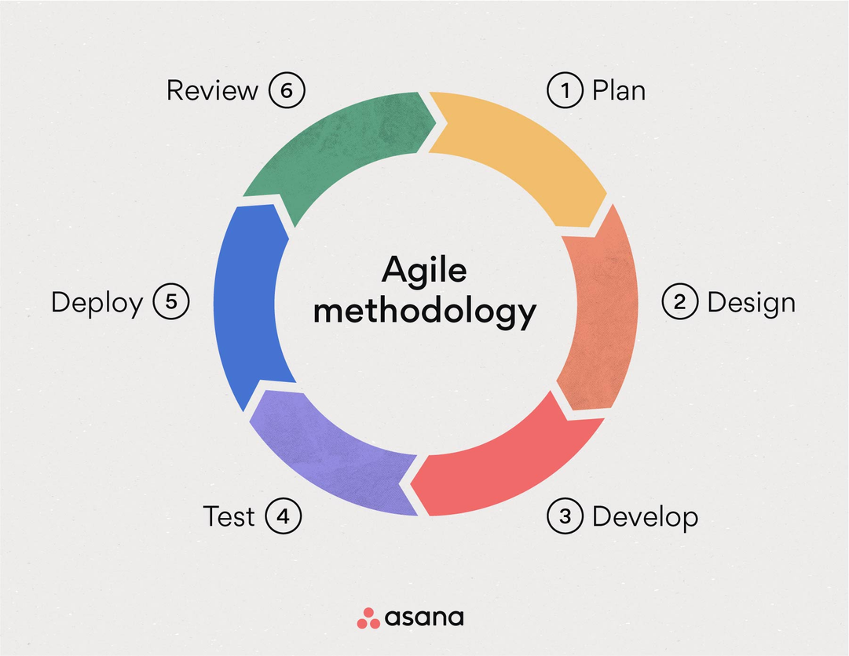

Project Management Style
Why Agile?
  Allows for continuous feedback and iterations from user testing.
  Flexibility in adapting to hardware and software changes, especially with sensor integration.
  Regular sprints to ensure progress and timely adjustments.

Slide 4
Task Decomposition
Category | Details
Hardware Integration | Connect and test pressure sensors. Ensure that the sensors produce readable and logic data.
Mobile App Development | Design, implement, and test the mobile app (Android).
Wireless Connectivity | Integrate Bluetooth module (HC-05) to ensure data transfer between patch and app.
Data Processing | Develop algorithms to process pressure data and trigger alerts.
Testing & Validation | Simulate real-world conditions and conduct user testing with adaptive athletes.

Slide 5

Key Milestones
Week | Week 2 | Week 4 | Week 5 | Week 6 (Current) | Upcoming (Week 8)
Accomplished | Researched relevant pressure sensors on the market and ordered multiple sensors for testing. | Initial app UI/UX design and user flow created. | Tested sensors for accuracy and responsiveness | Developed the basic foundation for the mobile application, integrating core UI elements and preparing for sensor data integration. | Complete Bluetooth connectivity integration and start real-time data transmission between patch and app.

Slide 6

Metrics & Evaluation Criteria
  Accuracy of Pressure Readings: Measured through controlled tests.
  User Experience: Athlete feedback on ease of use and responsiveness.
  Alert Timeliness: Ensure alerts are triggered within seconds of detecting harmful pressure levels.
  Battery Life: Optimize system for extended use without frequent charging.
  Application: User friendly & easy to navigate

Slide 7



Key Risks & Mitigation
Risk
Sensor malfunctions or inaccuracies
Bluetooth connectivity issues in dynamic sports environments
App crashes during monitoring
Mitigation
Thorough sensor testing before deployment; redundant sensors as backups.
Testing in various environments and improving signal range.
Regular stress testing and memory management in the app code.

Slide 8
Conclusion
Summary
Next Steps
Goal
Agile development process supports iterative improvements, real-world testing, and adaptability.
Deliver a reliable solution for athletes by April 2025. Deliver a prototype by the end of Fall 2024 semester.
Connect the sensors to the application. Get logical readings and analyze data

